Slide 1
Introduction to Microsoft®
Security Development Lifecycle (SDL)
Threat Modeling
Secure software made easier
Presenter Name
Date
Notes:
Hi, I’m ___ and I’m here today to talk to you about the approach to threat modeling used in the Microsoft Security Development Lifecycle (SDL).

Slide 2
Course Overview
Introduction and Goals
How to Threat Model
The STRIDE per Element Approach to Threat Modeling
Diagram Validation Rules of Thumb
Exercise
Demo
Notes:
This course takes roughly 2 hours, and includes an exercise and a tool demo. The agenda is we’ll start out by discussing the goals of threat modeling, explain exactly how to do it—even if you’re not an expert– and then go to an exercise to make things concrete, as well as a demo of the SDL Threat Modeling tool to show you how to make this easy.

Slide 3
Introduction and Goals
Notes:
Let’s go through the goals of threat modeling.

Slide 4
Terminology and Context
All engineers
SDL
Threat Modeling
Core People involved
Security Experts
“Internet Engineering Task Force” (IETF)
Threat Modeling
Development stage
Requirements Design Design analysis
Notes:
To get started, let’s understand that threat modeling means a lot of different things to different people. I want to be clear about what we mean when we say SDL threat modeling. We mean a design analysis technique that’s been designed to ensure that all engineers can participate, not only security experts. This is in contrast to (for example) the IETF. There, it’s a perfectly reasonable question to ask “What’s your threat model?” and hear the complete answer be “someone with control over a top level domain.”
That approach isn’t wrong, but it doesn’t work for everyone, and so Microsoft has developed a new approach, centered on analyzing designs, and that’s what we’re going to talk about today.

Slide 5
Threat Modeling Basics
Who?
  The bad guys will do a good job of it
  Maybe you will…your choice
What?
  A repeatable process to find and address all threats to your product
When?
  The earlier you start, the more time to plan and fix
  Worst case is for when you’re trying to ship: Find problems, make ugly scope and schedule choices, revisit those features soon
Why?
  Find problems when there’s time to fix them
  Security Development Lifecycle (SDL) requirement
  Deliver more secure products
How?
Notes:
Let’s go through the who/what/why/when/how of integrating threat modeling into your development process.
Who will threat model? The bad guys will look at your designs and find flaws in them. You can if you want to, and if you do, you have time to plan to address those issues.
(walk through when & why)
How? That’s the subject of the rest of this presentation

Slide 6
Who
Building a threat model (at Microsoft)
  Program Manager (PM) owns overall process
  Testers
    Identify threats in analyze phase
    Use threat models to drive test plans
  Developers create diagrams
Customers for threat models
  Your team
  Other features, product teams
  Customers, via user education
  “External” quality assurance resources,
  such as pen testers
You’ll need to decide what fits to your organization
Notes:
So who’s involved in creating the threat model? “You” isn’t a very precise answer. There’s two groups involved: first are the team that builds it, and second are the teams that consume it.
The folks that build it are dev, test and PM. At Microsoft, program managers are a mix of project manager, product manager and architect who define what the overall product will be. All three have a role in the creation of threat models. Some teams have their testers own the threat model—the tester’s approach to the world is often a good one for finding issues with designs.
Creating great threat models is going to require that the threat models be part of your development process, not just documents that sit on a shelf. Working to ensure that threat models are widely consumed is important. So let’s look at some of the customers for threat models:
Your team, when new people come on board, or when you hit major development milestones.
If you’re working on a large project, talk to other feature teams. Review your threat models together to make sure you understand the security expectations of each side.
If there are external security notes in your threat model, some of that data may go to your customers.
If you hire pen testers or other security QA, showing them your threat models will save you time and money.

Slide 7
What
Consider, document, and discuss security in a structured way
Threat model and document
  The product as a whole
  The security-relevant features
  The attack surfaces
Assurance that threat modeling has been done well
Notes:
What is threat modeling? What benefits does it bring? There’s three things:
Consider, document, and discuss security in a structured way. Structure is important for consistency and cross-group collaboration.
You want to threat model your entire product. It doesn’t make sense to threat model, say, the Bold button in Word. You want to threat model Word.
You want to think about the security features, like logging or cryptography in detail.
You also want to think about the parts of the code which are most exposed – the attack surfaces.
The final thing you get from threat modeling documents is assurance that the work has been done. It’s no good to have the world’s best security experts sit around and think about the problem if they don’t share their results.

Slide 8
Why
Produce software that’s secure by design
  Improve designs the same way we’ve improved code
Because attackers think differently
  Creator blindness/new perspective
Allow you to predictably and effectively
find security problems early in the process
Notes:
We’ve done a lot to improve code in the SDL. From effective training to compiler improvements to banned APIs , the code has gotten a lot better. We need to improve our designs as well.
It’s hard to get a clean perspective on your own code. You spend a lot of time and effort to get it right, it’s hard to get a fresh look at it. The approach we’re teaching you today helps you do that.

Slide 9
How to Threat Model
Notes:
Is the subject of the remainder of the slides.
(Run through these next few slides quickly)

Slide 10
SSDP
8
SSDP
10
Get version
info
Cache Castle
info
Set version
info
Query other
Castle info
Read
Castle info
Publish this
Castle info
Manage
Castle
Explorer
(or rundl132)
2
Local User
1
Manage
Castle
Join, leave,
Set users props
Feedback
Castle
Service
8
Remote
Castle
Service
9
Feedback
Query users props
Set acct info
Get acct info
Get machine
password
Set psswd
Shacct
4
Set acct info
Get acct info
Notes:
Zip through this – so you draw a diagram like this one … (next slide)

Slide 11
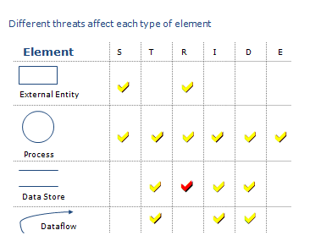
SSDP
8
SSDP
10
Get version
info
Cache Castle
info
Set version
info
Query other
Castle info
Read
Castle info
Publish this
Castle info
Local User
1
Explorer
(or rundl132)
2
Manage
Castle
Castle
Service
8
Join, leave,
Set users props
Remote
Castle
Service
9
Feedback
Query users props
Set acct info
Get acct info
Get machine
password
Set psswd
Shacct
4
Set acct info
Get acct info
Notes:
“apply stride threats per element, document it all, and you’re done!” (next slide)

Slide 12
Any Questions?
Everyone understands that?
Spotted the several serious bugs?
Let’s step back and build up to that
Notes:
Read the slide. Then ”threat modeling is intimidating, and can feel like that.”

Slide 13
The STRIDE per Element Approach to Threat Modeling

Slide 14
The Process in a Nutshell
Diagram
Identify Threats
Mitigate
Validate
Notes:
So this is the general approach. It looks like most software processes you’ve seen. Two things: The vision stage is optional, and so is the loop. You really only need to loop if you make design changes.

Slide 15
The Process: Diagramming
Diagram
Identify Threats
Mitigate
Validate

Slide 16
How to Create Diagrams
Go to the whiteboard
Start with an overview which has:
  A few external interactors
  One or two processes
  One or two data stores (maybe)
  Data flows to connect them
Check your work
  Can you tell a story without edits?
  Does it match reality?

Slide 17
Diagramming
Use DFDs (Data Flow Diagrams)
  Include processes, data stores, data flows
  Include trust boundaries
  Diagrams per scenario may be helpful
Update diagrams as product changes
Enumerate assumptions, dependencies
Number everything (if manual)

Slide 18
Diagram Elements: Examples
External Entity
Data
Flow
Process
Data Store
People
Other systems
Microsoft.com
DLLs
EXEs
COM object
Components
Services
Web Services
Assemblies
Function call
Network traffic
Remote
Procedure Call
(RPC)
Database
File
Registry
Shared
Memory
Queue / Stack
Trust Boundary
Process boundary
File system

Slide 19
Diagrams: Trust Boundaries
Add trust boundaries that intersect data flows
Points/surfaces where an attacker can interject
  Machine boundaries, privilege boundaries, integrity boundaries are examples of trust boundaries
  Threads in a native process are often inside a trust boundary, because they share the same privs, rights, identifiers and access
Processes talking across a network always have a trust boundary
  They make may create a secure channel, but they’re still distinct entities
  Encrypting network traffic is an ‘instinctive’ mitigation
    But doesn’t address tampering or spoofing

Slide 20
Diagram Iteration
Iterate over processes, data stores, and see where they need to be broken down
How to know it “needs to be broken down?”
  More detail is needed to explain security impact of the design
  Object crosses a trust boundary
  Words like “sometimes” and “also” indicate you have a combination of things that can be broken out
    “Sometimes this datastore is used for X”…probably add a second datastore to the diagram

Slide 21
Context Diagram
Resource integrity information
iNTegrity App
Administrator
Analysis Instructions
Notes:
Now to put this all together, we’re going to look at a simple system for change detection in an enterprise.

Slide 22
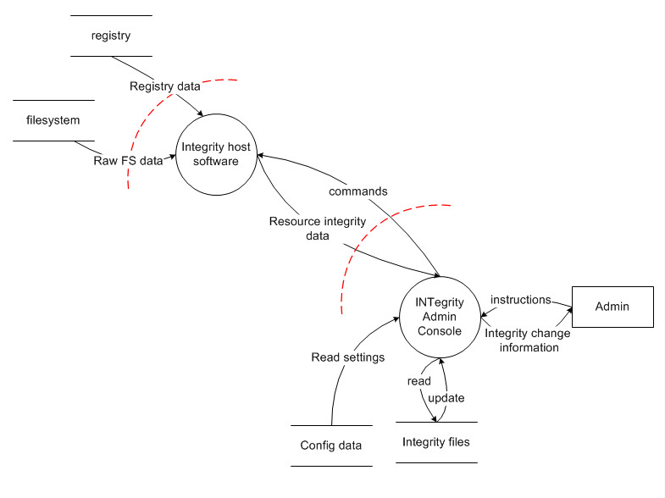
Level 1 Diagram
Notes:
We have an admin console that gathers filesystem & registry data from one or more monitored hosts in the field. We’ll come back to this in the exercise.

Slide 23
Diagram layers
Context Diagram
  Very high-level; entire component / product / system
Level 1 Diagram
  High level; single feature / scenario
Level 2 Diagram
  Low level; detailed sub-components of features
Level 3 Diagram
  More detailed
  Rare to need more layers, except in huge projects or when you’re drawing more trust boundaries

Slide 24
Creating Diagrams: analysis or synthesis?
Top down
  Gives you the “context” in context diagram
  Focuses on the system as a whole
  More work at the start
Bottom up
  Feature crews know their features
  Approach not designed for synthesis
  More work overall
Notes:
FINDME: If your team has made a call on this, you can eliminate this slide

Slide 25
Diagram Validation
Rules of Thumb
Notes:
These rules of thumb are derived from Microsoft’s analysis of threat models and are designed to make it easier to know if you’re doing the right thing. Even if you’re using the tool—which automates these– its important to know where they come from.

Slide 26
Diagram Validation Rules of Thumb
  Does data magically appear?
  Data comes from external entities or data stores
Order
Customer
Web Server
SQL Database
Confirmation

Slide 27
Diagram Validation Rules of Thumb
  Are there data sinks?
  You write to a store for a reason: Someone uses it.
Transaction
Analytics
Web Server
SQL Server Database

Slide 28
Diagram Validation Rules of Thumb
  Data doesn’t flow magically
Order Database
Returns Database

Slide 29
Diagram Validation Rules of Thumb
  It goes through a process
Order Database
RMA
Returns Database

Slide 30
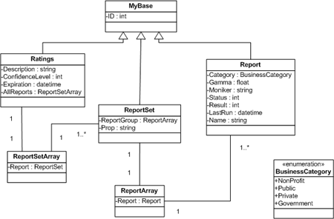
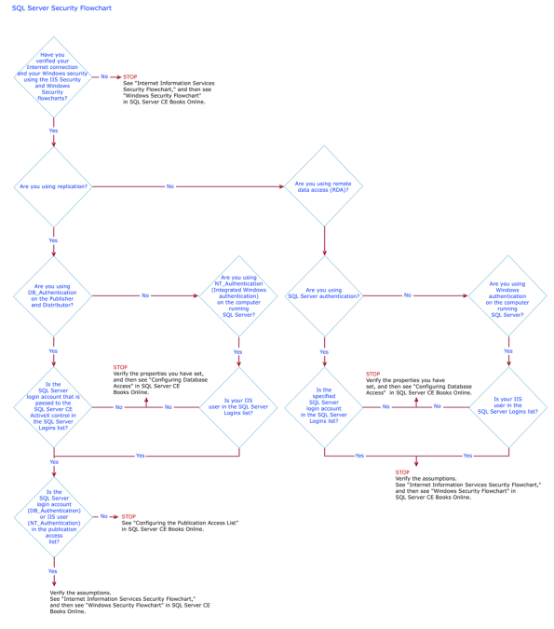
Diagrams Should Not Resemble
Flow charts
Class diagrams
Call graphs

Slide 31
Real Context Diagram (“Castle”)
Castle Config
Feedback

Slide 32
Castle Level 1 Diagram
SSDP
8
SSDP
10
Get version
info
Cache Castle
info
Set version
info
Query other
Castle info
Read
Castle info
Publish this
Castle info
Local
User
1
Manage
Castle
Explorer
(or rundl132)
2
Manage
Castle
Feedback
Castle
Service
8
Join, leave,
Set users props
Remote
Castle
Service
9
Feedback
Query users props
Set acct info
Get acct info
Get machine
password
Set psswd
Shacct
4
Set acct
Info
Get acct info
Notes:
I usually ask people in the class to improve this diagram. Where should there be trust boundaries? What’s the wrong shape? What happens in what order?
Do point out that none of the data flows are labeled “read” or “write,” and that’s a good thing. You get read/write from the direction of the arrow.

Slide 33
The Process: Identifying Threats
Diagram
Identify Threats
Mitigate
Validate
Notes:
The next phase of the process is to identify threats. How do you do this without being an expert?

Slide 34
Identify Threats
Experts can brainstorm
How to do this without being an expert?
  Use STRIDE to step through the diagram elements
  Get specific about threat manifestation
Threat Property we want
Spoofing | Authentication
Tampering | Integrity
Repudiation | Nonrepudiation
Information Disclosure | Confidentiality
Denial of Service | Availability
Elevation of Privilege | Authorization
Notes:
Self explanatory. The next slides go into more detail, with examples

Slide 35
Threat: Spoofing
Threat | Spoofing
Property | Authentication
Definition | Impersonating something or someone else
Example | Pretending to be any of billg, microsoft.com, or ntdll.dll

Slide 36
Threat: Tampering
Threat | Tampering
Property | Integrity
Definition | Modifying data or code
Example | Modifying a DLL on disk or DVD, or a packet as it traverses the LAN

Slide 37
Threat: Repudiation
Threat | Repudiation
Property | Non-Repudiation
Definition | Claiming to have not performed an action
Example | “I didn’t send that email,” “I didn’t modify that file,” “I certainly didn’t visit that Web site, dear!”

Slide 38
Threat: Information Disclosure
Threat | Information Disclosure
Property | Confidentiality
Definition | Exposing information to someone not authorized to see it
Example | Allowing someone to read the Windows source code; publishing a list of customers to a Web site

Slide 39
Threat: Denial of Service
Threat | Denial of Service
Property | Availability
Definition | Deny or degrade service to users
Example | Crashing Windows or a Web site, sending a packet and absorbing seconds of CPU time, or routing packets into a black hole

Slide 40
Threat: Elevation of Privilege
Threat | Elevation of Privilege (EoP)
Property | Authorization
Definition | Gain capabilities without proper authorization
Example | Allowing a remote Internet user to run commands is the classic example, but going from a “Limited User” to “Admin” is also EoP

Slide 41
Different Threats Affect Each Element Type
ELEMENT
S T R I D E


External Entity






Process

?


Data Store



Data Flow
Notes:
These are the threats which affect each type of element. For example, data flows are subject to tampering, information disclosure and denial of service.
Data stores are subject to tampering, information disclosure and denial of service, and if they’re logs, impact repudiation:
Data stores which are logs come under special attack because they’re logs.
Logs can act as a pass through—lots of security software looks at logs. Be careful about what you write.
If a system has no logs, repudiation is easy.

Slide 42
Apply STRIDE Threats to Each Element
For each item on the diagram:
  Apply relevant parts of STRIDE
  Process: STRIDE
  Data store, data flow: TID
    Data stores that are logs: TID+R
  External entity: SR
  Data flow inside a process:
    Don’t worry about T, I, or D
This is why you number things

Slide 43
Use the Trust boundaries
Trusted/ high code reading from untrusted/low
  Validate everything for specific and defined uses
High code writing to low
  Make sure your errors don’t give away too much

Slide 44
Threats and Distractions
Don’t worry about these threats
  The computer is infected with malware
  Someone removed the hard drive and tampers
  Admin is attacking user
  A user is attacking himself
You can’t address any of these (unless you’re the OS)

Slide 45
The Process: Mitigation
Diagram
Identify Threats
Mitigate
Validate

Slide 46
Mitigation Is the Point of Threat Modeling
Mitigation
  To address or alleviate a problem
Protect customers
Design secure software
Why bother if you:
  Create a great model
  Identify lots of threats
  Stop
So, find problems and fix them
Notes:
A list of STRIDE Standard Mitigations is included at the end of the presentation

Slide 47
Mitigate
Address each threat
Four ways to address threats
  Redesign to eliminate
  Apply standard mitigations
    What have similar software packages done and how has that worked out for them?
  Invent new mitigations (riskier)
  Accept vulnerability in design
    SDL rules about what you can accept
Address each threat
Notes:
Mitigations not /gs

Slide 48
Standard Mitigations
Spoofing | Authentication | To authenticate principals: Cookie authentication Kerberos authentication PKI systems such as SSL/TLS and certificates To authenticate code or data: Digital signatures
Tampering | Integrity | Windows Vista Mandatory Integrity Controls ACLs Digital signatures
Repudiation | Non Repudiation | Secure logging and auditing Digital Signatures
Information Disclosure | Confidentiality | Encryption ACLS
Denial of Service | Availability | ACLs Filtering Quotas
Elevation of Privilege | Authorization | ACLs Group or role membership Privilege ownership Input validation

Slide 49
Inventing Mitigations Is Hard: Don’t do it
Mitigations are an area of expertise, such as networking, databases, or cryptography
Amateurs make mistakes, but so do pros
Mitigation failures will appear to work
  Until an expert looks at them
  We hope that expert will work for us
When you need to invent mitigations, get expert help

Slide 50
Sample Mitigation
Mitigation #54, Rasterization Service performs the following mitigation strategies:
  OM is validated and checked by (component) before being handed over to Rasterization Service
  The resources are decoded and validated by interacting subsystems, such as [foo], [bar], and [boop]
  Rasterization ensures that if there are any resource problems while loading and converting OM to raster data, it returns a proper error code
  Rasterization Service will be thoroughly fuzz tested
    (Comment: Fuzzing isn’t a mitigation, but it’s a great thing to plan as part 4)

Slide 51
Improving Sample Mitigation:
Validated-For
“OM is validated and checked by [component] before being handed over to Rasterization Service”
Validated for what? Be specific!
  “…validates that each element is unique.”
  “…validates that the URL is RFC-1738 compliant, but note URL may be to http://evil.com/ownme.html”
  (Also a great external security note)

Slide 52
The Process: Validation
Diagram
Identify Threats
Mitigate
Validate

Slide 53
Validating Threat Models
Validate the whole threat model
  Does diagram match final code?
  Are threats enumerated?
  Minimum: STRIDE per element that touches a trust boundary
  Has Test / QA reviewed the model?
    Tester approach often finds issues with threat model or details
  Is each threat mitigated?
  Are mitigations done right?
Did you check these before Final Security Review?
  Shipping will be more predictable

Slide 54
Validate Quality of Threats and Mitigations
Threats: Do they:
  Describe the attack
  Describe the context
  Describe the impact
Mitigations
  Associate with a threat
  Describe the mitigations
  File a bug
    Fuzzing is a test tactic, not a mitigation

Slide 55
Validate Information Captured
Dependencies
  What other code are you using?
  What security functions are in that other code?
  Are you sure?
Assumptions
  Things you note as you build the threat model
    “HTTP.sys will protect us against SQL Injection”
    “LPC will protect us from malformed messages”
    GenRandom will give us crypto-strong randomness

Slide 56
More Sample Mitigations
Mitigation #3: The Publish License is created by RMS, and we've been advised that it's only OK to include an unencrypted e-mail address if it's required for the service to work. Even if it is required, it seems like a bad idea due to easy e-mail harvesting.
Primary Mitigation: Bug #123456 has been filed against the RMS team to investigate removing the e-mail address from this element. If that's possible, this would be the best solution to our threat.
Backup Mitigation: It's acceptable to mitigate this by warning the document author that their e-mail address may be included in the document. If we have to ship it, the user interface will be updated to give clear disclosure to the author when they are protecting a document.

Slide 57
Effective Threat Modeling Meetings
Develop draft threat model before the meeting
  Use the meeting to discuss
Start with a DFD walkthrough
Identify most interesting elements
  Assets (if you identify any)
  Entry points/trust boundaries
Walk through STRIDE against those elements
Threats that cross elements/recur
  Consider library, redesigns
Notes:
This is one of the only mentions of assets, because many software developers can’t identify them effectively.

Slide 58
Pause for Questions
Before Exercise

Slide 59
Exercise

Slide 60
Exercise
Handout
Work in teams to:
  Identify all diagram elements
  Identify threat types to each element
  Identify at least three threats
  Identify first order mitigations
Extra credit: Improve the diagram
Notes:
I leave this slide up during the exercise.
Working in teams is important—it draws people in and gets the energy level in the room way up. I usually announce 10 minutes for this, and end up giving people 15. You can adjust this time to fit how quickly or slowly you’ve gone through the material. You need to plan for a discussion (see the “Identify threats” slide) and also a tool demo and wrap-up.

Slide 61
Identify All Elements (16 Elements)
7
…and two trust boundaries, which don’t have threats against them
8
3
10
9
6
11
16
1
2
13
15
12
14
4
5
Notes:
Sometimes people don’t count data flows; other times they count trust boundaries. Everyone should understand why there are 16 elements.

Slide 62
Identify Threat Types to Each Element
  Identify STRIDE threats by element type
Threats Elements
ELEMENT
S T R I D E


Administrator (1)
External Entity






Admin console (2) , Host SW (3)
Process




Config data (4), Integrity data (5),
Filesystem data (6), registry (7)
Data Store



8. raw reg data
raw filesystem data
commands
.... 16
Data Flow
Notes:
I prep a chart like this to help me make sure I consider each element.
For administrator, I can walk across, looking for S, R
For admin console, I look for STRIDE. (etc)

Slide 63
Identify Threats!
Be specific
Understand threat and impact
Identify first order mitigations
Notes:
For each element of the chart starting with spoofing against external entities I ask “Who found X?” You may want a printout of the chart handy for your own use for this.
I ask whoever pops up to identify the threat, explain it, and its impact, and then how they’d mitigate it. Plan for 15 minutes here, feel free to cut to no less than 10.

Slide 64
Demo
Notes:
http://www.microsoft.com/sdl
Demo script provided seperately.

Slide 65
Call to Action
Threat model your work!
  Start early
  Track changes
Work with a Security Advisor!
Talk to your “dependencies” about security assumptions
Learn more

Slide 66
Threat Modeling Learning Resources
MSDN Magazine
Reinvigorate your Threat Modeling Process
  http://msdn.microsoft.com/en-us/magazine/cc700352.aspx
Threat Modeling: Uncover Security Design Flaws Using The STRIDE Approach
  http://msdn.microsoft.com/msdnmag/issues/06/11/ThreatModeling/default.aspx
Article
Experiences Threat Modeling at Microsoft
  http://download.microsoft.com/download/9/D/3/9D389274-F770-4737-9F1A-8EA2720EE92A/Shostack-ModSec08-Experiences-Threat-Modeling-At-Microsoft.pdf
SDL Blog
  All threat modeling posts
  http://blogs.msdn.com/sdl/archive/tags/threat%20modeling/default.aspx
Books
  The Security Development Lifecycle: SDL: A Process for Developing Demonstrably More Secure Software
  (Howard, Lipner, 2006) “Threat Modeling” chapter
  http://www.microsoft.com/mspress/books/authors/auth8753.aspx
Notes:
Note that the advice in the book is somewhat dated. In fact, all of the books are a little dated, and the advice here is current as of 2008.

Slide 67
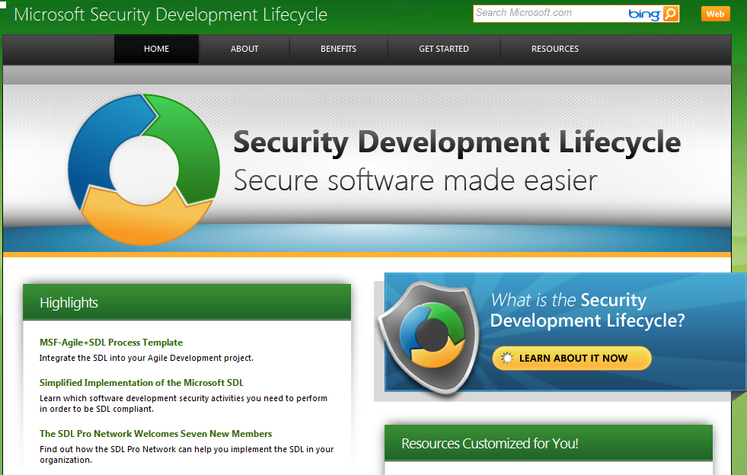
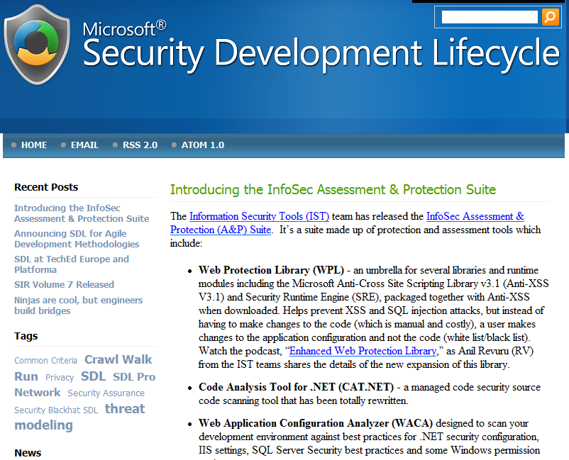
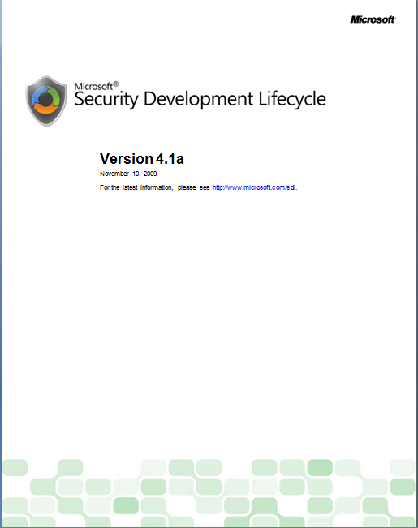
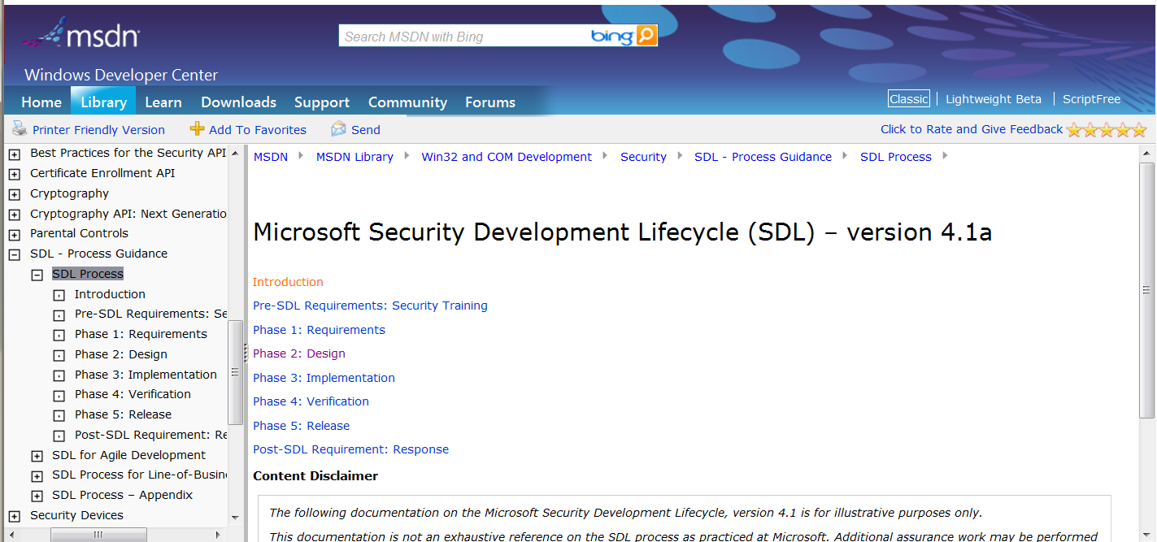
Resources
SDL Portal
http://www.microsoft.com/sdl
SDL Blog
http://blogs.msdn.com/sdl/
SDL Process on MSDN (Web)
http://msdn.microsoft.com/en-us/library/cc307748.aspx
SDL Process on MSDN (MS Word)
http://go.microsoft.com/?linkid=9694872

Slide 68
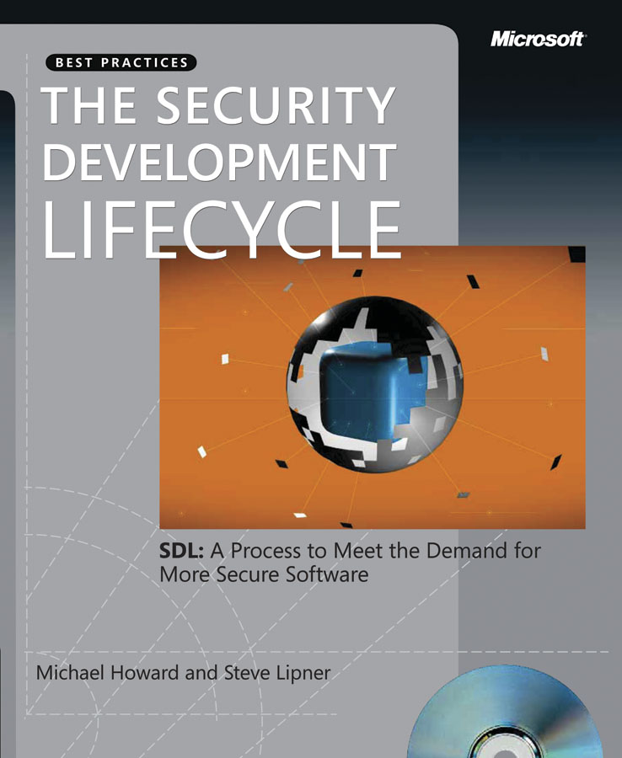
Questions?

Slide 69

© 2008 Microsoft Corporation. All rights reserved. Microsoft, Windows, Windows Vista and other product names are or may be registered trademarks and/or trademarks in the U.S. and/or other countries.
The information herein is for informational purposes only and represents the current view of Microsoft Corporation as of the date of this presentation. Because Microsoft must respond to changing market conditions, it should not be interpreted to be a commitment on the part of Microsoft, and Microsoft cannot guarantee the accuracy of any information provided after the date of this presentation.
MICROSOFT MAKES NO WARRANTIES, EXPRESS, IMPLIED OR STATUTORY, AS TO THE INFORMATION IN THIS PRESENTATION.
Notes:
Version 2.06, Feb 25 2007

Slide 70
Backup Slides
Notes:
http://www.microsoft.com/sdl
Demo script provided separately.

Slide 71
Standard Mitigations
S T R I D E
Threat | Property we want
Spoofing | Authentication
Tampering | Integrity
Repudiation | Nonrepudiation
Information Disclosure | Confidentiality
Denial of Service | Availability
Elevation of Privilege | Authorization
Notes:
This approach strikes me as tremendously tedious to teach through.

Slide 72
Standard Mitigations
S T R I D E
Threat | Property
Spoofing | Authentication | To authenticate principals: Basic authentication Digest authentication Cookie authentication Windows authentication (NTLM) Kerberos authentication PKI systems, such as SSL or TLS and certificates IPSec Digitally signed packets To authenticate code or data: Digital signatures Message authentication codes Hashes

Slide 73
Standard Mitigations
S T R I D E
Threat | Property
Tampering | Integrity | Windows Vista mandatory integrity controls ACLs Digital signatures Message authentication codes

Slide 74
Standard Mitigations
S T R I D E
Threat | Property
Repudiation | Nonrepudiation | Strong authentication Secure logging and auditing Digital signatures Secure time stamps Trusted third parties

Slide 75
Standard Mitigations
S T R I D E
Threat | Property
Information Disclosure | Confidentiality | Encryption ACLs

Slide 76
Standard Mitigations
S T R I D E
Threat | Property
Denial of Service | Availability | ACLs Filtering Quotas Authorization High-availability designs

Slide 77
Standard Mitigations
S T R I D E
Threat | Property
Elevation of Privilege | Authorization | ACLs Group or role membership Privilege ownership Permissions Input validation

